Slide 1
Analyzing Median House Prices and School Ratings for Scarborough Canada for Immigrants Applied Data Science Capstone IBM Data Science Professional Certificate

Slide 2
Problem
Many people migrating to many places where is better such as having better facilities, more secure, etc. This project aim to analysis of feature neighborhood as a comparative analysis between neighborhood. The feature including postal code and position of the neighborhood, so this would help people to decide where they should be migrating from clustering.

Slide 3
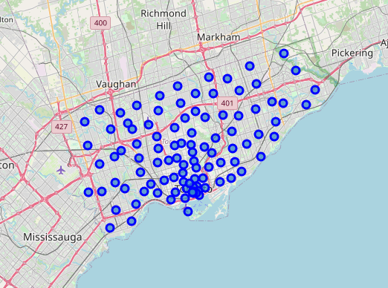
Algorithm
There are many neighborhoods surrounded, so we can find the closest neighborhood around the target by using clustering. From clustering we can see that there are many groups around the target.

Slide 4
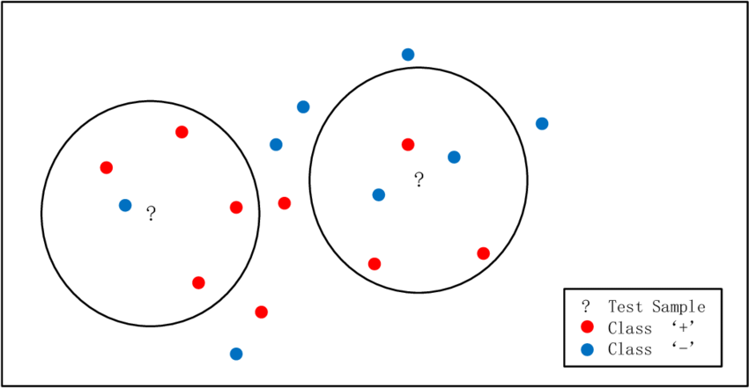
Algorithm
KNN (K- nearest neighbor) is a non-parametric method used for classification and regression. In both cases, the input consists of the k closest training examples in the feature space. The output depends on whether k-NN is used for classification or regression

Slide 5
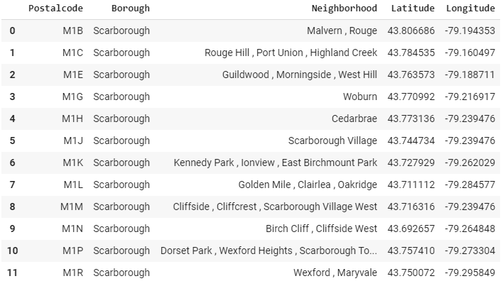
Data requirement
Name of neighborhoods.
Post code of the neighborhoods.
Position of the neighborhoods.

Slide 6
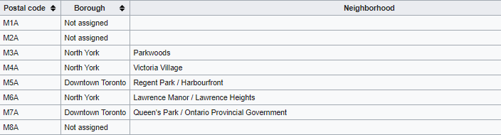
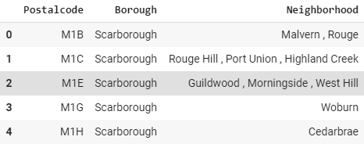
Data preprocessing
From the table below we can that there are some value of the Neighborhood is empty. There are 3 ways we can handle with them, but it is discrete data we cannot find the average of them or set them to zero. We can do just only drop them down.

Slide 7
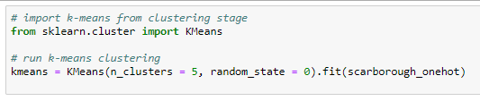
Modeling
After the data is preprocessed. We can use KNN find the cluster of the data.

Slide 8
Conclusion
In this project, through the KNN algorithms. We can find the cluster of the data into 3 groups.

Slide 9
Thank you

